Slide 1



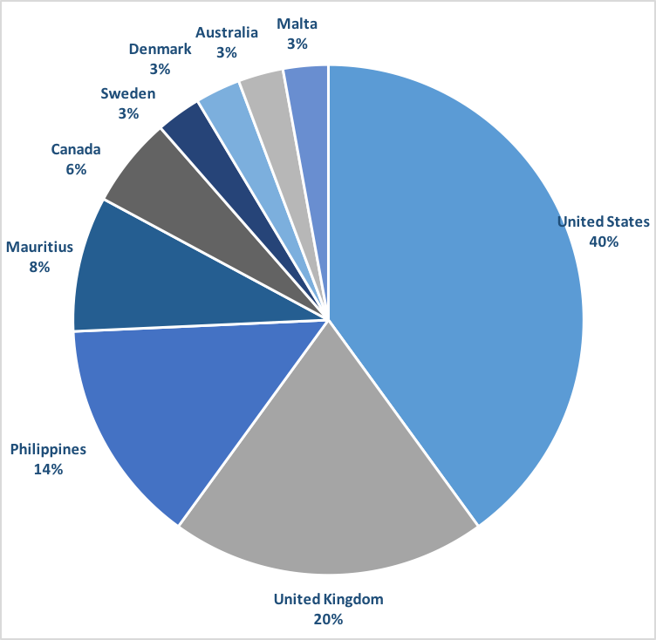
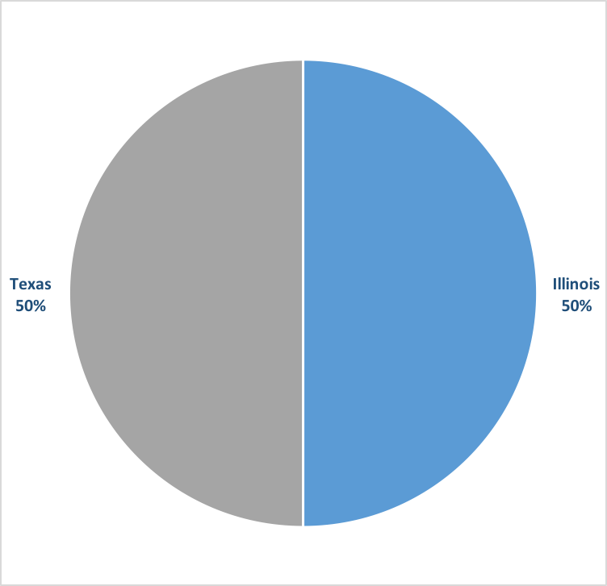
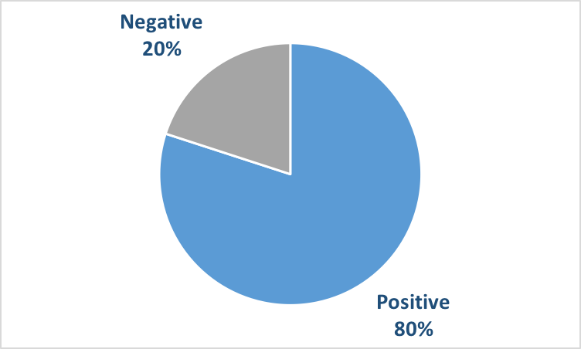
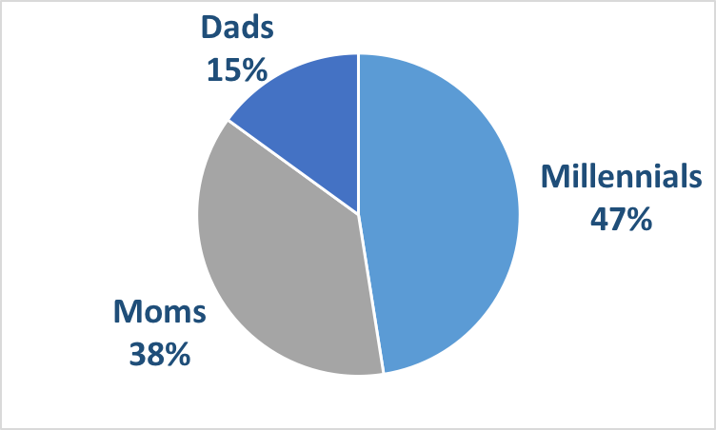
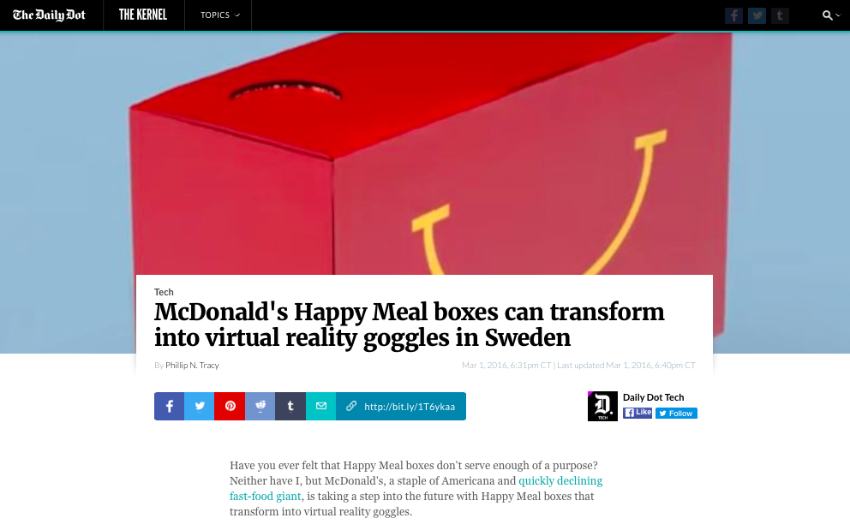
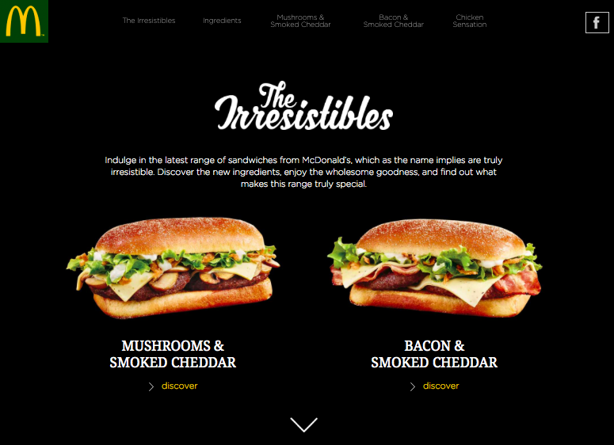
Happy Goggles Facebook Topic Data Insights
Run Dates: 3/10/2016 – 3/14/2016
McDonald’s Happy Goggles Insights Summary
PURPOSE: Insightpool aggregated every Facebook interaction relative to McDonald’s Happy Goggles, and recorded 4.5k interactions between March 10th and March 14th. The purpose of this analysis was to gauge the volume, topics, sentiment, and demographics of the conversation over a short window of time to demonstrate insights surface insights from Facebook Topic Data.
Insights:
(1) 6% of the conversation came from Scandinavia with 94% positive sentiment from USA and only 16% positive sentiment from UK.
(2) Millennials had a 100% positive reaction to the goggles, while parents, purchasers of Happy Meals, had just 67% positive sentiment.
Recommendations:
(1) When considering rolling out the Happy Goggles to new markets, the USA should be considered if the trend of positive sentiment continues.
(2) Because of the positive sentiment from millennials, McDonald’s could consider introducing the goggles as packaging for meals often purchased by millennials if volume from millennials continues to manifest in the data.
Location Insights
During the brief window that Insightpool aggregated all private and public McDonald’s Happy Goggles conversation on Facebook, 94% of the conversation came from outside Scandinavia. The United States’ conversation had 100% positive sentiment towards McDonald’s Happy Goggles. 50% of the USA conversation was associated with Ronald McDonald House Charities.
Percentage of Interactions Across Countries
Percentage of Interactions Across United States
Conversation Insights
Sentiment
Personas
Links
While the index sentiment was 20% negative, conversations from parents was 33% negative siting issues of cleanliness.
Parents only accounted for 53% of the conversation while the Millennial conversation was 100% positive.
50%- The Daily Post
50%- http://mcdonalds.com.mt/irresistibles/

